Slide 1
CSF 2113 Programming for Information Security
Containers (CLO 1)
Muhammad Humayoun, PhD
Assistant Professor
mhumayoun@hct.ac.ae
Abu Dhabi Men’s College

Slide 2
Containers
Lists A collection of values.
String data type
Tuples A collection of values as a record.
Dictionaries A table of name, value pairs.

Slide 3
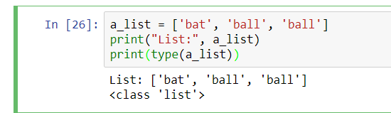
Lists
Elements
A list is a sequence of values (objects).
Individual values in a list are called elements.
Lists have a type and are considered values themselves.
To write a literal list (values)in your program, use the square brackets:
The length of a_list is 3 (the number of elements)
>>> print(len(a_list)) # gives 3 (an integer)

Slide 4
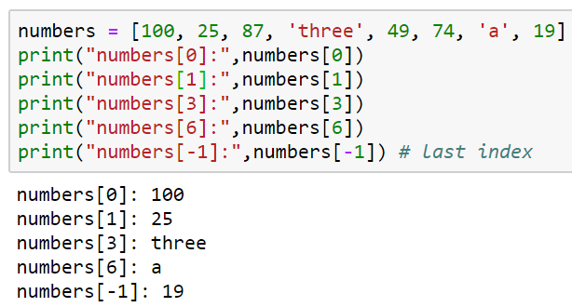
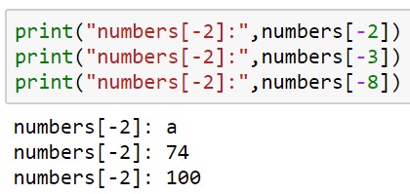
Working with lists
Lists may contain elements of different types (though unusual)
Elements are numbered starting from zero
As with strings, we call this the position or index of the element
Accessing values in a list:
To index from the last element u
have to start by -1
Value | 100 | 25 | 87 | three | 49 | 74 | a | 19
index | 0 | 1 | 2 | 3 | 4 | 5 | 6 | 7
 | -8 | -7 | -6 | -5 | -4 | -3 | -2 | -1

Slide 5
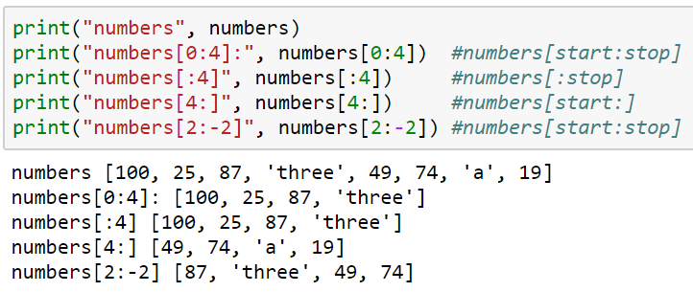
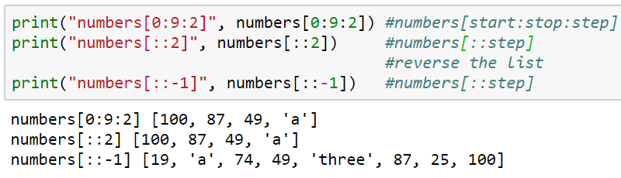
List Slicing
Range: [start:stop:step] all optional
Try numbers[0:100]
List element from index 0 to 100 should be shown.
Since the max index is 7, the whole will be shown without an error

Slide 6
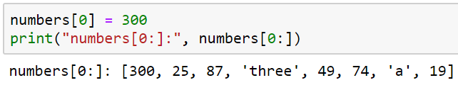
List mutability( editing of the list)
Lists are mutable, they can be changed in several ways:
Appending or inserting a new element
Removing an element
Sorting and reversing
Changing the values of existing elements with assignment
Number[0}= 89
This will change the value of element in the index 0

Slide 7
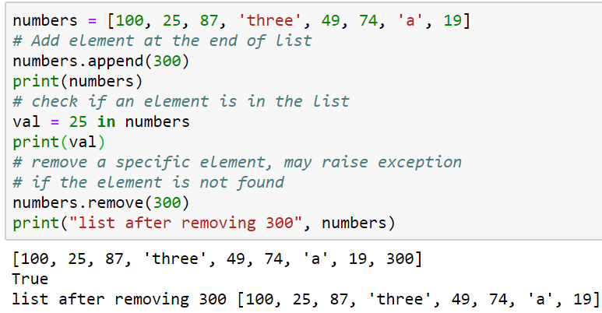
Adding new things to a list
Add elements: The append method adds a new element to the end of a list
Append= to add one values one element
The append method:
Mutates the list
Increases the length by one
Does NOT return a value
# gives [100, 25, 87, ‘three’, 49, 74, ‘a’, 19, 300]
Extending a list( for whole list)
To add a whole list to the end, use the extend method
scores = [80, 70, 60]
scores.extend([55, 88, 79])
# gives [80, 70, 60, 55, 88, 79 ]
This increases the length by 3
Returns nothing!

Slide 8
What if you used append instead of extend? (from previous slide)
sc = [80, 70, 60]
sc.append ([55, 88, 79])
Would give [ 80, 70, 60, [55, 88, 79] ]
Adds the list as a single element
The insert method adds a new element at a given location
sc.insert (2, “Rana”)
The new element will be at position 2 (that is, two elements to the left of it)
The other elements move to the right to make room, so no data is lost
[ 80, 70, “Rana”, 60, [55, 88, 79] ]
Remove elements from a list:
This call will remove the first occurrence of 300 from the list numbers
Exception/error if the element not found

Slide 9
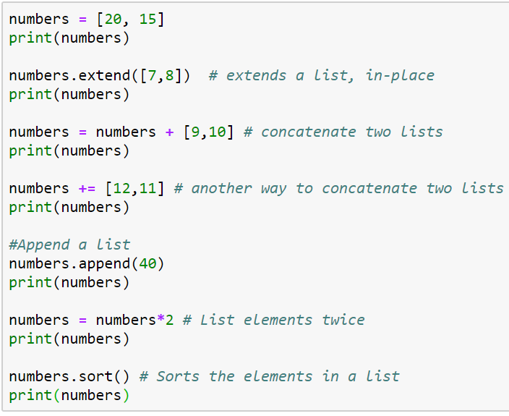
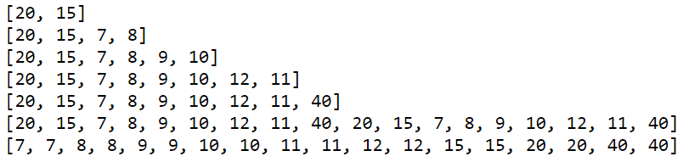
Lets do it together... Mathamatical operation = extends
Beware: list vs. element

Slide 10
Mutation versus making new objects
Notice that append, extend and insert return nothing!
Most mutating functions in Python work this way
With a few exceptions later
So do NOT do this
Numbers= numbers.append(255) = # ERROR – it will make numbers = None!
Instead:
numbers.append(255) # GOOD – adds 255 at end
Conversely, concatenating with + does NOT mutate the list
Instead, it returns a new list
So do NOT do this
numbers + scores # ERROR – does not store the new longer list
Instead:
numbers = numbers + scores # or numbers += scores

Slide 11
Searching in lists
There are two ways to search for an element in a list:
You can use the in operator to check whether it’s there:
>>>students = ["Tahir", "Ali", "Anas"]
>>>b = "Tahir" in students
>>>print(b)
The in operator checks for that exact element, does not look “inside” elements
>>>“Hawk” in students # False!
To find an element’s position in the list, use the index method
loc = students.index(“Ali”) # loc is 1
An Exception/error is thrown if this element is not in the list

Slide 12
Reversing a list
The reverse method reverses the order of a list
mylist = [“red”, “green”, “blue”]
mylist.reverse()
print(mylist) #gives [“blue”, “green”, “red”]
reverse mutates the list!
The original order is lost
And reverse does not return a value
So do NOT do this:
mylist = mylist.reverse() # ERROR – mylist becomes None !

Slide 13
Reversing a list
If you need a new reversed copy of the list, use
backwards = list(reversed(mylist))
For this one, mylist is unchanged, backwards is a new list
Note the difference:
reverse is a method that mutates the list that is its argument
reversed is a function that returns a new sequence
It does not actually return a list, but you can convert it with the list typecast

Slide 14
Sorting a list
You can also sort a list using the sort method
Defaults to ascending order
scores = [ 75, 63, 92 ]
scores.sort()
print(scores) # gives [63, 75, 92]
For strings, that means alphabetic (ASCII) order
physicists = [“Taher”, “Shahab”, “Husnain”]
physicists.sort()
print(physicists) # [“Husnain”, “Shahab”, “Taher”]

Slide 15
Sorting a list
Can do descending order instead:
scores.sort(reverse = True)
print(scores) # gives [92, 75, 63]
To make a new sorted list and keep the original list too
ordered_list = sorted(scores)
# does not mutate scores
scores is unchanged
sorted does make a new list
Similar to the difference between reverse and reversed

Slide 16
How to create a list
We’ve seen several different ways we can make a list:
Hard code it: lst = [ 1, 2, 3]
Start out with an empty list and append to it
lst = []
lst.append(1)
lst.append(2)
Useful as an accumulator
Start out with an empty list and concatenate to it
lst = []
lst += [1]
lst += [2]

Slide 17
How to create a list (cont’d)
Split a string: lst = “one two three”.split()
Replication: lst = [0] * 100
Makes a list with 100 elements, each one zero
Will have another when we get to external data files (readlines method)

Slide 18
Some more examples of lists
List | Description
[] | An empty list
[1,1,2,3,5,8] | A list of integers
[42, "What's the question?", 3.1415] | A list of mixed data types
["Stuttgart", "Freiburg", "München", "Nürnberg", "Würzburg", "Ulm","Friedrichshafen", Zürich", "Wien"] | A list of Strings
[["London","England", 7556900], ["Paris","France",2193031], ["Bern", "Switzerland", 123466]] | A nested list
["High up", ["further down", ["and down", ["deep down", "the answer", 42]]]] | A deeply nested list

Slide 19
2. String data type
There are different ways to define strings in Python:
>>> s = 'I am a string enclosed in single quotes.'
>>> s2 = "I am a string enclosed in double quotes."
Escaping with a backslash (\):
>>> s3 = 'It doesn\'t matter!’
s3=“hii “how are u doing” “ check it in python
>>> s3 = "It doesn't matter!" # no need of backslash
>>> txt = "He said: \"It doesn't matter\""
>>> print(txt)
He said: "It doesn't matter"
>>>

Slide 20
String data type
Triple-quoted strings
unescaped newlines and quotes are allowed and retained
txt = '''A string in triple quotes can extend
over multiple lines like this one, and can contain
'single' and "double" quotes.'''

Slide 21
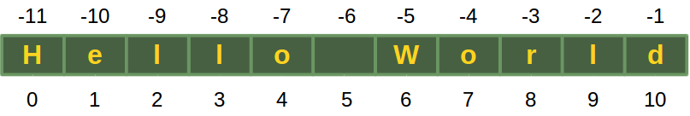
Extracting individual characters from a string
String consists of a series or sequence of characters (letters, numbers, special characters, space, tab, etc)
The characters in a string are numbered from 0 to length -1
>>> s = "Hello World" # length = 11 (from 0 to 10)
You can use square brackets to get the character at a given position
first = s[0] # this is “H”
This is called subscripting or indexing
The position must be smaller than the length
print(s[11]) # ERROR: string index out of range

Slide 22
String length
The length of a string is the number of characters in it.
Spaces count!
To get the length of a string, use the len function:
s = "Hello World"
numchars = len(s) # that’s 11 characters
Argument type: string
Return type: integer
What’s len(“”)?
0

Slide 23
Extracting characters with negative subscripts
You can subscript with negative numbers, counting from the right end
s[-1] is the last, rightmost character
s[-2] is the next to last character
…
s[-len(name)] is the first, left most character

Slide 24
Strings are Immutable
Python strings cannot be changed once created. That is strings are immutable
>>> s = "Some things are immutable!"
>>> s[1] = "."
Traceback (most recent call last):
File "<stdin>", line 1, in <module>
TypeError: 'str' object does not support item assignment
>>>

Slide 25
Basic String Operations
Concatenation( only for String type) "Hello" + "World" → "HelloWorld"
Repetition String can be repeated or repeatedly concatenated with the asterisk operator "*":
"*-*" * 3 → "*-**-**-*"
Slicing Substrings can be created with the slice or slicing notation: "Python"[2:4] will result in "th"
Size len("Python") will result in 6

Slide 26
Basic String Operations
We can’t perform any other mathematical operations on strings, even if the strings look like numbers
The following are illegal:
'2‘ - '1‘
'eggs'/'easy'
'third‘ * 'a charm‘

Slide 27
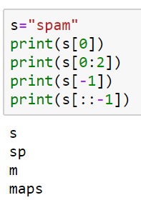
List and string
A string is a sequence of characters and a list is a sequence of values, but a list of characters is not the same as a string. To convert from a string to a list of characters, you can use list:
>>> s = 'spam'
>>> t = list(s)
>>> t
['s', 'p', 'a', 'm']

Slide 28
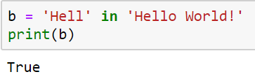
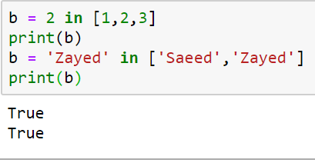
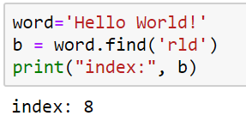
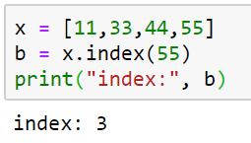
Strings versus lists
You’ve probably noticed a lot of similarities between lists and strings
Sometimes the very same code works with both!
len, subscripts, slicing
Traversal
Concatenation
But there are also many differences
Each element in a string is a character (a string of length 1)
But the elements of a list can be anything
Strings, numbers, bools, even other lists!
With strings, in searches for a substring
With lists, in searches for whole elements onsubstring (-1 if not found)
Lists use index to locate an error (error if not foundly!
Strings use find to locate a)
Another big difference: lists are mutable

Slide 29
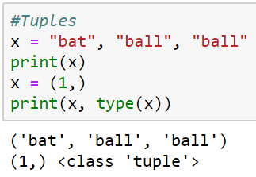
3. Tuples
Tuples are a collection of data items. They may be of different types. Tuples are immutable (like strings).
Same as lists but Immutable
Python optionally uses brackets () to denote tuples
We could have also used () for the above tuple
If we have only one item, we need to use a comma to indicate it's a tuple: e.g. (“Bat”,)

Slide 30
Immutable Types
Strings and Tuples are immutable, which means that once you create them, you can not change them.
The assignment operator (=) can make a variable point to strings or tuples just like simple data types:
myString = “This is a test”
myTuple = (1,45.8, True, “String Cheese”)‏
it contain numbers , bollean and string)
Strings & Tuples are both sequences, which mean that they consist of an ordered set of elements, with each element identified by an index.

Slide 31
Working with Tuples
Most list operators also work on tuples. The bracket operator indexes an element
>>> t = ("tuples", "are", "immutable")
>>> t[0]
'tuples'
>>> t[0]="assignment not possible"
Traceback (most recent call last):
File "<stdin>", line 1, in <module>
TypeError: 'tuple' object does not support item assignment
Immutable Type

Slide 32
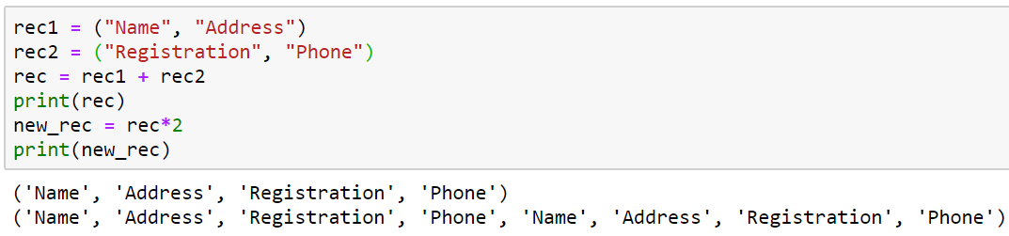
Working with Tuples
The slice operator selects a range of elements:
>>> t = ('a', 'b', 'c', 'd', 'e')
>>> t[1:3]
('b', 'c')
Try
Range: [start:stop:step]
+ and *

Slide 33
Sorting tuples
>>> atuple = (33, 22, 11)
>>> atuple.sort() Traceback (most recent call last): … AttributeError: 'tuple' object has no attribute 'sort'
>>> atuple = sorted(atuple)
>>> atuple [11, 22, 33]
Tuples are immutable!
sorted( ) returns a list!

Slide 34
Most other things work!
>>> atuple = (11, 22, 33)
>>> len(atuple) 3
>>> 44 in atuple False
Converting sequences into tuples
>>> alist = [11, 22, 33]
>>> atuple = tuple(alist)
>>> atuple (11, 22, 33)
>>> newtuple = tuple('Hello World!')
>>> newtuple ('H', 'e', 'l', 'l', 'o', ' ', 'W', 'o', 'r', 'l', 'd', '!')

Slide 35
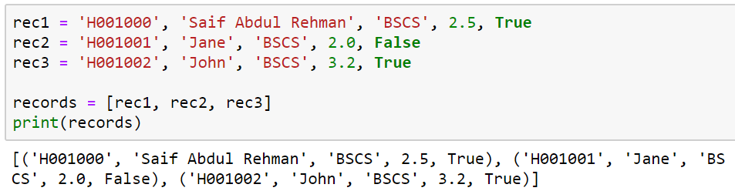
List of Tuples
Tuple is a record
So a list of records could be constructed

Slide 36
4. Dictionaries( Key: value)= pair
A dictionary is like a list, but more general.
In a list, the indices have to be integers; in a dictionary they can be (almost) any type.
Keys must be unique within a dictionary: No duplicates
Simply put, a dictionary is a list of key-value pairs.
empty_dict = {} # Empty dict Pythonic style
empty_dict2 = dict() # Empty dict less Pythonic
grades = { "Erik" : 80, "Tim" : 95 } # dictionary literal
Keys: “Erik”, “Tim”
Values: 80, 95
Key and values are separated by a colon
Paris of entries are separated by commas
Dictionary is enclosed within curly braces

Slide 37
Usage
If we have grades = { "Erik" : 80, "Tim" : 95 }
Look up the value for a key using square brackets
grades["Erik"] is 80 grades[“Tim"] is 95
KeyError if you ask for a key that’s not in the dictionary
kates_grade = grades["Kate"]

Slide 38
Check for the existence of a key using in:
erik_has_grade = "Erik" in grades # True
kate_has_grade = "Kate" in grades # False
Using get method to return a value:
eriks_grade = grades.get("Erik", 0) # equals 80
kates_grade = grades.get("Kate", 0) # equals 0
no_ones_grade = grades.get("No One") # default is None
You assign key-value pairs using the same square brackets:
grades["Tim"] = 99 # replaces the old value
grades["Kate"] = 100 # adds a third entry
num_students = len(grades) # equals 3

Slide 39
Displaying contents
>>> age = {'Alice' : 25, 'Carol': 'twenty-two'}
>>> age.items() dict_items([ ('Alice', 25), ('Carol', 'twenty-two')])
>>> age.keys() dict_keys([ 'Alice', 'Carol'])
>>> age.values() dict_values([25, 'twenty-two'])

Slide 40
Updating directories mutable
>>> age = {'Alice': 26 , 'Carol' : 22}
>>> age.update({'Bob' : 29})
>>> age {'Bob': 29, 'Carol': 22, 'Alice': 26}
>>> age.update({'Carol' : 23})
>>> age {'Bob': 29, 'Carol': 23, 'Alice': 26}

Slide 41
Dictionaries are mutable
>>> age = {'Alice' : 25, 'Bob' : 28}
>>> saved = age
>>> age['Bob'] = 29
>>> age {'Bob': 29, 'Alice': 25}
>>> saved {'Bob': 29, 'Alice': 25}

Slide 42
Dictionaries - a simple way to represent structured data:
tweet = {
"user" : “mhumayoun",
"text" : “Python is Awesome",
"retweet_count" : 100,
"hashtags" : ["#data", "#science", "#datascience"]
}
Besides looking for specific keys we can look at all of them:
tweet_keys = tweet.keys() # list of keys
tweet_values = tweet.values() # list of values
tweet_items = tweet.items() # list of (key, value) tuples
"user" in tweet_keys # True, but uses a slow list in
"user" in tweet # more Pythonic, uses faster dict in
“mhumayoun" in tweet_values # True

Slide 43
Summary of Containers or Compound Data Types
A data type in which the values are made up of elements that are themselves values
Strings – Enclosed in Quotes, holds characters, (immutable): “This is a String”
Lists – Enclosed in square brackets, separated by commas, holds any data type (mutable): [4, True, “Test”, 34.8]
Dictionaries – Enclosed in curly brackets, elements separated by commas, key : value pairs separated by colons, keys can be any immutable data type, values can be any data type (mutable): { 1 : “I”, 2 : ”II”, 3 : “III”, 4 : “IV”, 5 : “V” }
Tuples – Values separated by commas, (usually enclosed by parenthesis) and can hold any data type (immutable): (4 , True, “Test”, 34.8)‏

Slide 44
CSF 2113 Programming for Information Security
CLO1: Iterations
Muhammad Humayoun, PhD
Assistant Professor
mhumayoun@hct.ac.ae
Abu Dhabi Men’s College

Slide 45
Loops / Iteration
for loop
range function
Flow control within loops: break, continue, pass, and the “loop else”

Slide 46
While: Overview
We can use a while statement to repeatedly execute a series of tasks (i.e. a loop).
Syntax Example
initialization n = 0
while condition: while n < 10:
statement(s) print n
increment/decrement n = n + 1

Slide 47
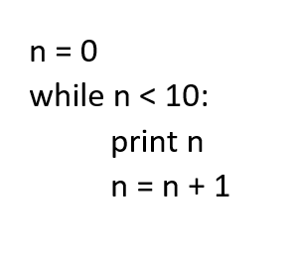
While: Control Flow
Evaluate condition (which is a Boolean expression).
If condition is False, then exit loop and continue program.
If condition is True, then execute statements in body and then go to step 1.

Slide 48
While: Notes
Each time through the body of a loop is called an iteration.
The condition normally contains a variable that changes within the body of the loop so that we can eventually exit the loop.
If a loop never exits, then this is called an infinite loop.

Slide 49
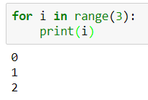
for loop: for ... in pattern
Used with collection data types which can be iterated through (“iterables”):
for i in [0,1,2] : print (i) Output: 0 1 2
Extract one element from the list.
Execute the body of for loop with item bound to the element.
Go to step 1.

Slide 50
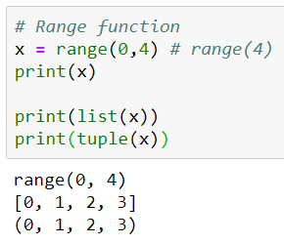
The range function…
range(n) returns a list of integers from 0 to n-1.
range(0, 10, 2) returns a list 0, 2, 4, 6, 8
Similarly we have
str(), int(), float(), ….

Slide 51
Simple examples
Print each fruit in a fruit list:
fruits = ["apple", "banana", "cherry"] for x in fruits: print(x)
Looping Through a String
Loop through the letters in the word "banana":
for x in "banana": print(x)

Slide 52
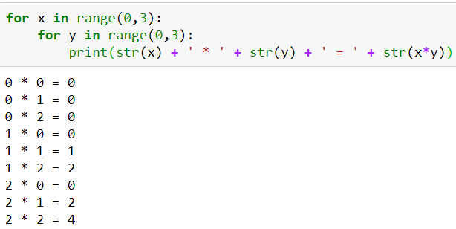
Nested loops

Slide 53
Activity: Loop Exercise
Find the smallest item in a list of numbers.

Slide 54
Flow control within loops
General structure of a loop: while <statement> (or for <item> in <object>): <statements within loop> if <test1>: break # exit loop now if <test2>: continue # go to top of loop now if <test3>: pass # does nothing! else: <other statements> # if exited loop without # hitting a break

Slide 55
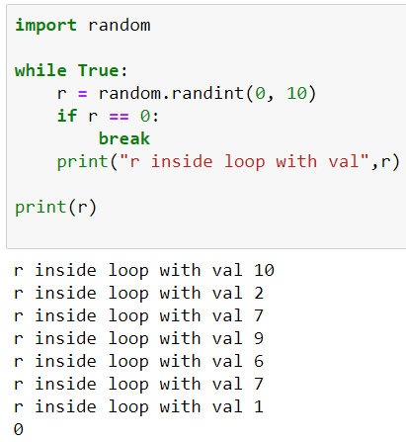
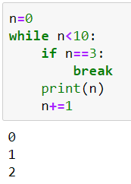
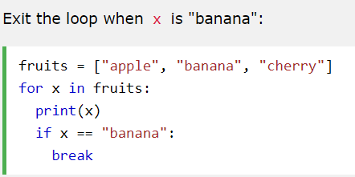
Break
We can exit a loop immediately by using the break statement
apple
banana
Important to observe where do you break

Slide 56
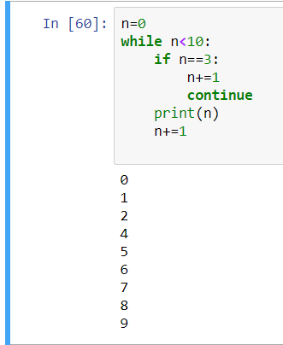
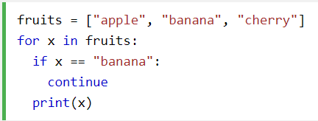
Continue
We can skip the rest of the loop body and move on to the next iteration by using continue
apple
cherry

Slide 57
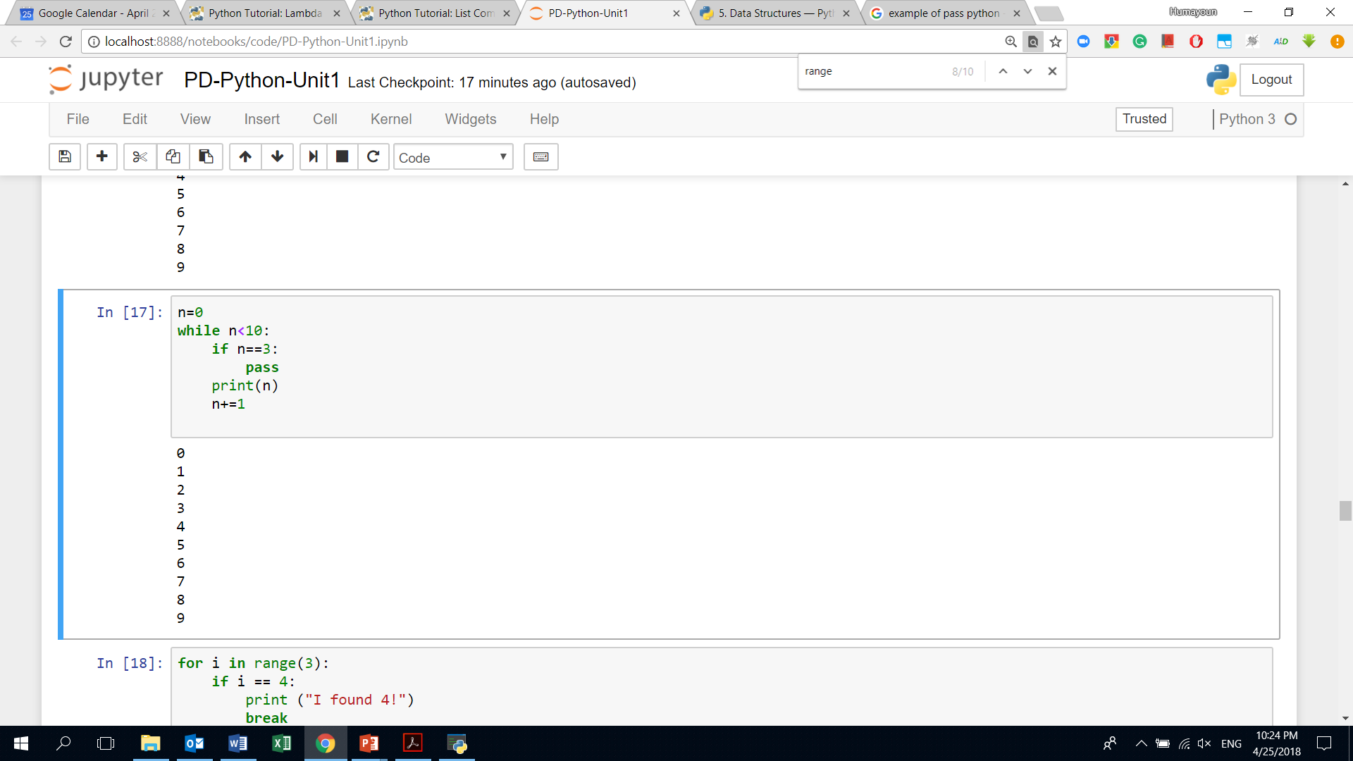
Pass
We do nothing
Can act as a placeholder
A typical example: designing a new class with some methods that we don't want to implement yet
https://stackoverflow.com/questions/13886168/how-to-use-the-pass-statement-in-python

Slide 58
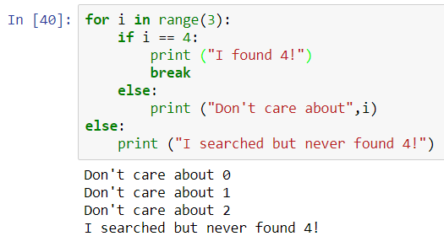
Using the “loop else”
An else statement after a loop is useful for taking care of a case where an item isn't found in a list:
for i in range(5):
if i==4:
print("i found 4!")
break
else:
print("dont care about ", i)
else:
print("i searched but i never found 4")

Slide 59
Activity: Guessing Game revisited
Write code that generates a random number between 0 and 100, and asks the user to guess what it is
Guess the number: 10 Guess a lower number!
Guess the number: 3 Guess a higher number!
Guess the number: 2 You got it!
If the guess is too low, tell the user to guess 'Higher!'
If the guess is too high, tell the user to guess 'Lower!'
End the program when the user has found the number

Slide 60
import random
r = random.randint(0,10)
while True:
Guess=int(input("Guess the number: "))
if(Guess==r):
print("You got it!")
break
elif(Guess<r):
print("guess higher")
else:
print("Guess lower")
Output
Guess the number: 10
Guess lower
Guess the number: 2
guess higher
Guess the number: 6
Guess lower
Guess the number: 4
You got it!

Slide 61
CSF 2113 Programming for Information Security
CLO1: Functions and Modules
Muhammad Humayoun, PhD
Assistant Professor
mhumayoun@hct.ac.ae
Abu Dhabi Men’s College

Slide 62
The idea behind functions
Sometimes we have to repeat the same combination of control structures and steps in several different places.
Functions let you write the code once and use it at multiple places
We’ve already seen several built-in and library functions
print(…), input(…)

Slide 63
Calling a function
And we know how to call them:
If it doesn’t return a value:
func(arguments)
If it does return a value:
result = func(arguments)

Slide 64
Calling a function: syntax
To call (“invoke”) a function, you write its name, followed by its arguments in parentheses ex. func(arguments)
The name of the function is an identifier
Same rules as for variable names
Letters, digits, underscore, cannot start with digit
The arguments are a list of expressions, separated by commas
Arguments are “inputs” that the calling statement sends to the function
Each function specifies how many arguments it takes
Some functions like random() take no arguments (But they still need parentheses!)

Slide 65
Calling a function: Semantics
The interpreter pauses execution of the code that made the function call
But it remembers where it was
The interpreter runs the code of the called function
It makes the arguments available to the function
The function finishes/returns
The interpreter picks up where it left off
The value of the function call Is whatever value the function returned (or None if it does not explicitly return anything)

Slide 66
Structured programming guarantees
When a subprogram (function) finishes, control returns to where the function was called from
A function should have ONE return statement as the last line of the function definition (One entrance, one exit guarantee)
or NO return statement, in which case all the statements in the definition are executed, then control returns to where it was called from

Slide 67
Defining a function
To define a function, you need to specify three things:
The name of the function
What parameters the function takes
With a name for each parameter
What the function does when called
The code or body of the function
As usual, an indented block

Slide 68
Defining functions
def name (parameters):
body
Defines a function called “name”
Goes at the top level of the file
Un-indented (at left margin)
Not inside main or other functions!
Parameters are a comma-separated list of identifiers
The function receives one argument for each parameter it has

Slide 69
Defining functions
When Python sees the definition, it does NOT run the body!
Instead it remembers it and remembers its name
The body runs when you call the function
If you don’t call a function, it will not run!
It does NOT run just because it is defined in the file
Something to check for when debugging

Slide 70
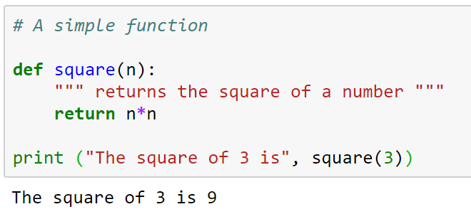
Functions
Function definitions can contain any control structure you like.
Ex: when square is called, the 3 is copied into the parameter n, before executing the body
What about with out returning satamtment
Remember the Terminology:
n is the parameter
3 is the argument (the value we give the parameter this time)
A function sends a value (or values) back to the caller by returning it (or them)
Now when you call square(val), it prints the square of that val
Body of the function should be indented consistently (4 spaces is typical in Python;
Beware of tabs -- AVOID THEM)‏

Slide 71
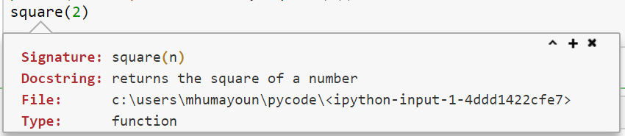
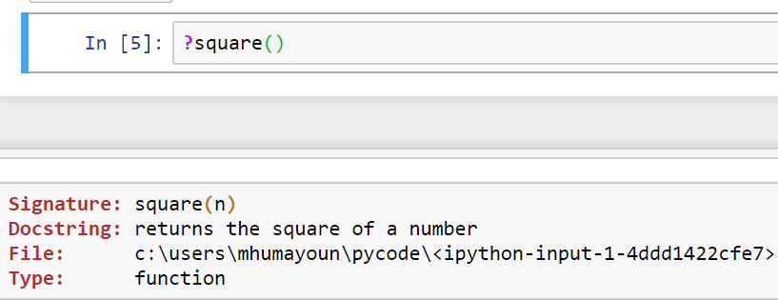
Docstring: Shift + Tab( information about the function)
Place your cursor inside function name and press “Shift+Tab”
Alternatively:

Slide 72
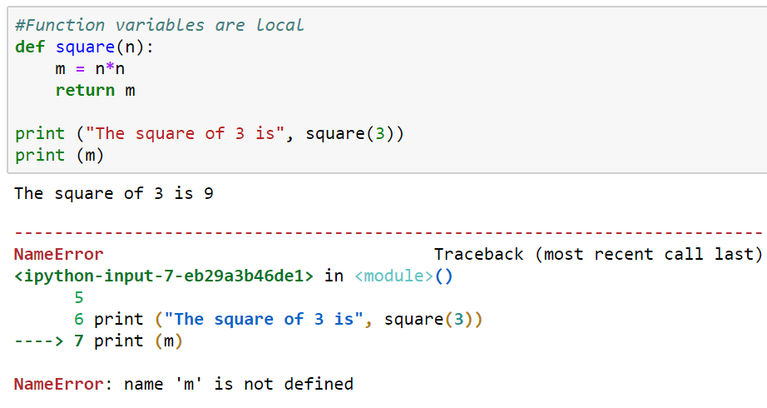
Function variables are local
Variables declared in a function do not exist outside that function
They are local
For example, m and n are local variables in square function
The locals only exist while the function is running
Lifetime or extent: the time during which a variable takes up memory
Variable is “born” when the function is initialized…
… and “dies” when the function it is in returns

Slide 73
Local variables
Other functions cannot see local variables at all!
The scope of the variable is which part of the code can see it
The scope of a local variable is the body of the function it is in, starting from its initialization
This means your function cannot refer directly to variables in other functions.
If you need access to information from another function
Use a parameter and argument to send information into a function
Use the return value to get information back out
A global variable is defined outside any function
Avoid these! Very hard to reason about, they can be changed by ANY function at ANY time!

Slide 74
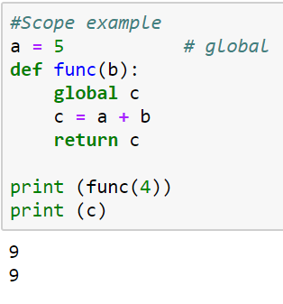
Scope example a= global c= global try with out return statement in the funcation

Slide 75
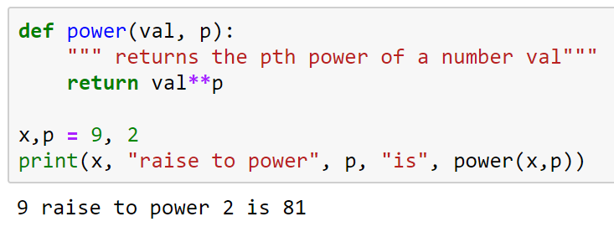
Functions with multiple parameters
Functions can have more than one parameter
When calling the function, you must supply the same number of arguments as parameters
power(5) #ERROR
power(5,3,4) #ERROR
If arguments are in wrong order, or if arguments are the wrong type, the function will eventually give an error
power(“Hello”, “this”) #ERROR

Slide 76
Functions without return values
All functions in Python return something.
If a return statement is not given, Python returns None
For example, the list append function changes the list but does not return a value: funcation, sort , reverse,doesnot have return
a = [0, 1, 2] b = a.append(3) print (b)
Output
None

Slide 77
Parameters/return values vs. input/output
parameters take “input” from the statement that calls the function
return value send “output” to the statement that called the function
input() takes input from the keyboard (the user)
print() sends output to the screen (the user)
Good functions usually use parameters and return a value,
Good functions do not usually use input and print
Then you can use them not only with user input…
… but also with graphical programs, files, computed data…
When should a function use input or print?
When the function’s sole purpose is to interact with the user

Slide 78
CSF 2113 Programming for Information Security
Fundamentals of File Handling
Muhammad Humayoun, PhD
Assistant Professor
mhumayoun@hct.ac.ae
Abu Dhabi Men’s College

Slide 79
I/O in Python: Reading a file
Python provides basic functions and methods necessary to manipulate files by default using a file object.
The open Function: Before you can read or write a file, you have to open it using Python's built-in open() function.
This function creates a file object, which would be utilized to call other support methods associated with it.
>>>file_object = open(file_name [, access_mode][, buffering])

Slide 80
file_object = open(file_name [, access_mode][, buffering])
file_name − The file_name argument is a string value that contains the name of the file that you want to access.
access_mode − The access_mode determines the mode in which the file has to be opened, i.e., read, write, append, etc. This is optional parameter and the default file access mode is read (r).
r: Opens a file for reading only. The file pointer is placed at the beginning of the file.
w: Opens a file for writing only. Overwrites the file if the file exists. If the file does not exist, creates a new file for writing.

Slide 81
I/O in Python: Reading a file
fobj = open("filename", "r")
The "r" is optional
Close it when finished working with the file
fobj.close()
access_mode:
Read: r
Write: w
Append:a
fobj = open("shakes.txt")
for line in fobj:
print(line.rstrip())
fobj.close()
Open shakes.txt file
Read file object fobj one line at a time
Print each line after stripping the whitespaces
Close the file object

Slide 82
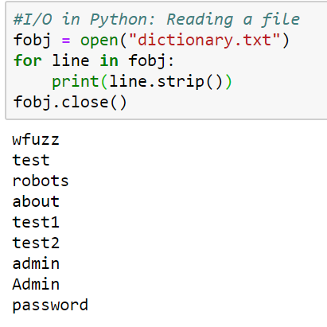
Reading a dictionary of passwords

Slide 83
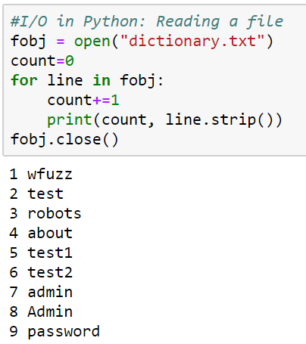
Activity: add line number with each line
# Reading a file
fobj = open("dictionary.txt")
for line in fobj:
print(line.strip())
fobj.close()

Slide 84
Reading in one go
Returns a list, convenient if the file is not too large
>>> text = open("dictionary.txt").readlines()
>>> print(text[:5])

Slide 85
Write into a File
fh = open("example.txt", "w")
fh.write("To write or not to write\nthat is the question!\n")
fh.close()
If the file example.txt already exits, it will be overwritten
To append an existing file use access mode “a”
fh = open("example.txt", "a")
fh.write("To write or not to write\nthat is the question!\n")
fh.close()

Slide 86
Activity: Reading and writing simultaneously
Read “dictionary.txt” line by line, add line number and then write it in a new file.

Slide 87
CSV: Comma Separated Values
CSV files are actually text files in which values are separated by comma
CSV is a simple file format used to store tabular data, such as a spreadsheet or database.
Files in the CSV format can be imported to and exported from programs that store data in tables, such as Microsoft Excel or OpenOffice Calc.

Slide 88
Reading records from a CSV file
SN | Name | City
1 | Michael | New Jersey
2 | Jack | California
3 | Donald | Texas
The records are represented as a text file:
SN, Name, City
1, Michael, New Jersey
2, Jack, California
3, Donald, Texas
We can read it the same way as you read a text file
fobj = open("name-city.csv")
for line in fobj:
print(line.strip())
fobj.close()

Slide 89
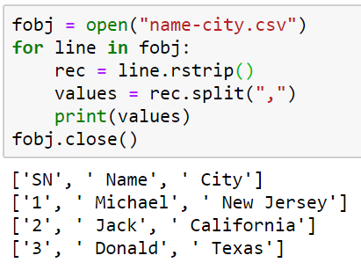
Processing the CSV further to extract a list of tuple
We want the file to convert into a list of tuple, where each tuple represents a record:
First attempt
[
(SN, Name, City)
(1, Michael, New Jersey),
(2, Jack, California),
(3, Donald, Texas)
]

Slide 90
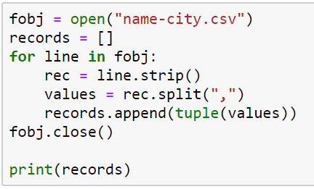
Processing the CSV further to extract a list of tuple
Final Attempt:

Slide 91
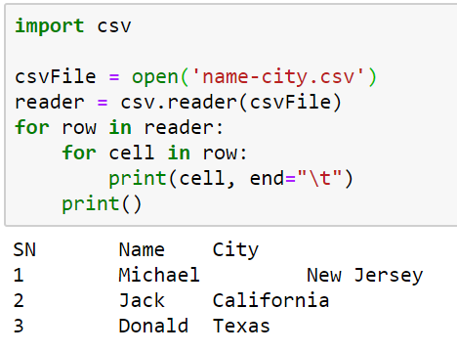
Using CSV library to read

Slide 92
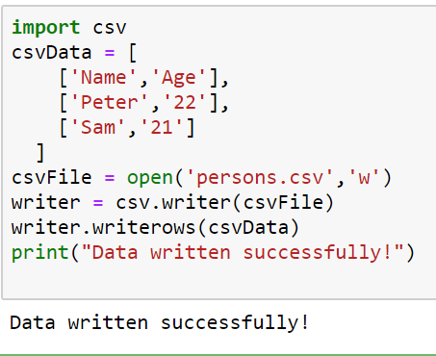
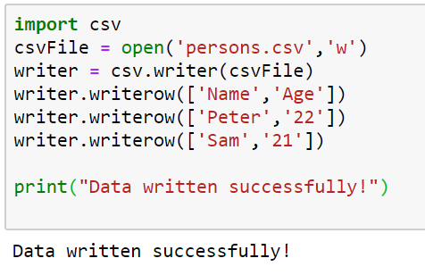
Using CSV file to write data

Slide 93
CSF 2113 Programming for Information Security
Fundamentals of File Handling
Muhammad Humayoun, PhD
Assistant Professor
mhumayoun@hct.ac.ae
Abu Dhabi Men’s College

Slide 94
I/O in Python: Reading a file
Python provides basic functions and methods necessary to manipulate files by default using a file object.
The open Function: Before you can read or write a file, you have to open it using Python's built-in open() function.
This function creates a file object, which would be utilized to call other support methods associated with it.
>>>file_object = open(file_name [, access_mode][, buffering])

Slide 95
file_object = open(file_name [, access_mode][, buffering])
file_name − The file_name argument is a string value that contains the name of the file that you want to access.
access_mode − The access_mode determines the mode in which the file has to be opened, i.e., read, write, append, etc. This is optional parameter and the default file access mode is read (r).
r: Opens a file for reading only. The file pointer is placed at the beginning of the file.
w: Opens a file for writing only. Overwrites the file if the file exists. If the file does not exist, creates a new file for writing.

Slide 96
I/O in Python: Reading a file
fobj = open("filename", "r")
The "r" is optional
Close it when finished working with the file
fobj.close()
access_mode:
Read: r
Write: w
Append:a
fobj = open("shakes.txt")
for line in fobj:
print(line.rstrip())
fobj.close()
Open shakes.txt file
Read file object fobj one line at a time
Print each line after stripping the whitespaces
Close the file object

Slide 97
Reading a dictionary of passwords

Slide 98
Activity: add line number with each line
# Reading a file
fobj = open("dictionary.txt")
for line in fobj:
print(line.strip())
fobj.close()

Slide 99
Reading in one go
Returns a list, convenient if the file is not too large
>>> text = open("dictionary.txt").readlines()
>>> print(text[:5])

Slide 100
Write into a File
fh = open("example.txt", "w")
fh.write("To write or not to write\nthat is the question!\n")
fh.close()
If the file example.txt already exits, it will be overwritten
To append an existing file use access mode “a”
fh = open("example.txt", "a")
fh.write("To write or not to write\nthat is the question!\n")
fh.close()

Slide 101
Activity: Reading and writing simultaneously
Read “dictionary.txt” line by line, add line number and then write it in a new file.

Slide 102
CSV: Comma Separated Values
CSV files are actually text files in which values are separated by comma
CSV is a simple file format used to store tabular data, such as a spreadsheet or database.
Files in the CSV format can be imported to and exported from programs that store data in tables, such as Microsoft Excel or OpenOffice Calc.

Slide 103
Reading records from a CSV file
SN | Name | City
1 | Michael | New Jersey
2 | Jack | California
3 | Donald | Texas
The records are represented as a text file:
SN, Name, City
1, Michael, New Jersey
2, Jack, California
3, Donald, Texas
We can read it the same way as you read a text file
fobj = open("name-city.csv")
for line in fobj:
print(line.strip())
fobj.close()

Slide 104
Processing the CSV further to extract a list of tuple
We want the file to convert into a list of tuple, where each tuple represents a record:
First attempt
[
(SN, Name, City)
(1, Michael, New Jersey),
(2, Jack, California),
(3, Donald, Texas)
]

Slide 105
Processing the CSV further to extract a list of tuple
Final Attempt:

Slide 106
Using CSV library to read

Slide 107
Using CSV file to write data

Slide 108
CSF 2113 Programming for Information Security
Web crawling with Scrapy (CLO4)
Muhammad Humayoun, PhD
Assistant Professor
mhumayoun@hct.ac.ae
Abu Dhabi Men’s College

Slide 109
Table of Contents
Crawler in Scrapy
Scraping interesting information about web application

Slide 110
Creating a Web Crawler with Scrapy
Decide what to scrap
First Scrapy project
Creating the spider for Scrapy
Running the crawler

Slide 111
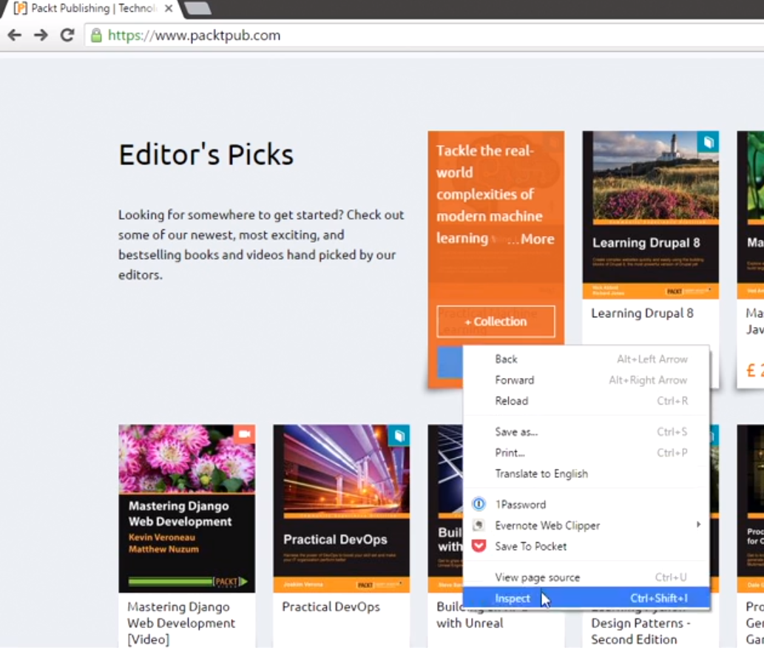
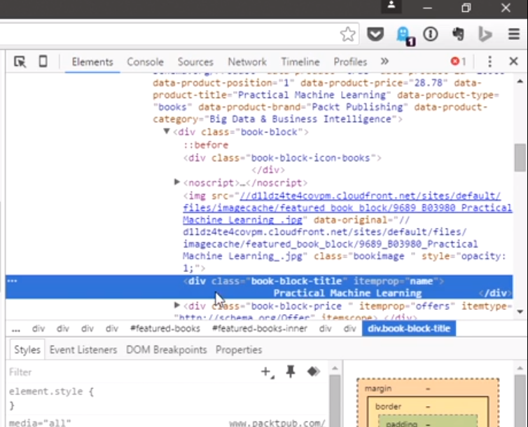
Decide what to scrap
We need to define the objective (Extract all book titles form www.packtpub.com)
Analyze the target: right click on a book title -> inspect

Slide 112
Scraping book titles
We can see div with a class of book-block-title and then the title name.
We need this to define what we want to extract in our crawl process
<div class=“book-block-title” itemprop=“name”>
Practical Machine Learning </div>

Slide 113
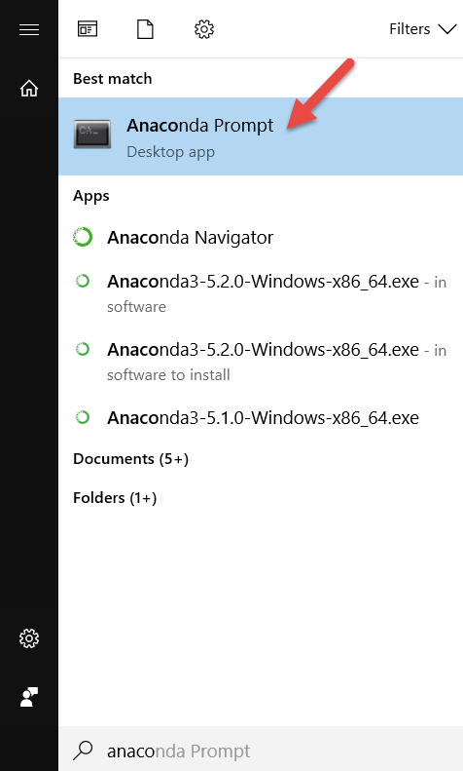
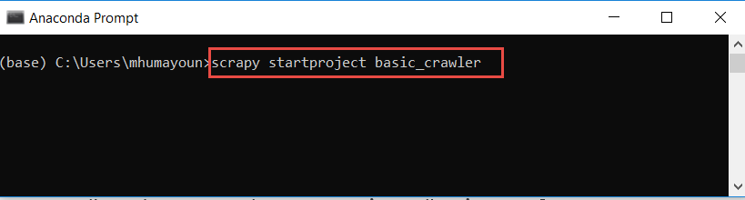
Creating first Scrapy project
Start a new Scrapy project:
$ scrapy startproject basic_crawler
New Scrapy project ‘basic_crawler’ created in:
/home/pentester/scrapy_projects/basic_crawler
You can start your first spider with:
cd basic_crawler
scrapy genspider example example.com
Execute the command in ‘Anaconda prompt’
(for windows 10,
in bash for Linux)

Slide 114
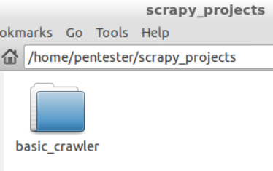
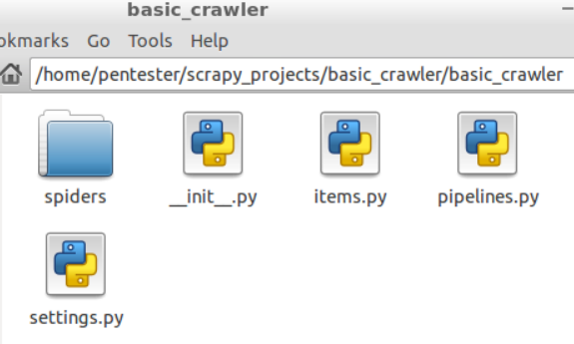
Creating first Scrapy project
Inside the basic_crawler directory, you will see another folder called basic_crawler
Start a new Scrapy project:
$ scrapy startproject basic_crawler
New Scrapy project ‘basic_crawler’ created in:
/home/pentester/scrapy_projects/basic_crawler
You can start your first spider with:
cd basic_crawler
scrapy genspider example example.com
When we create a project, Scrapy automatically generates a folder with the basic structure of the crawler
We shall work with the content of the spiders folder

Slide 115
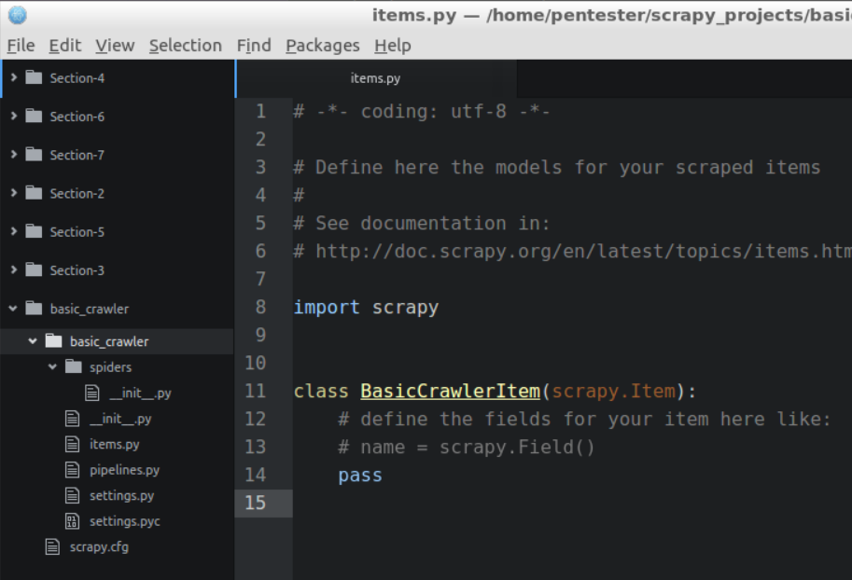
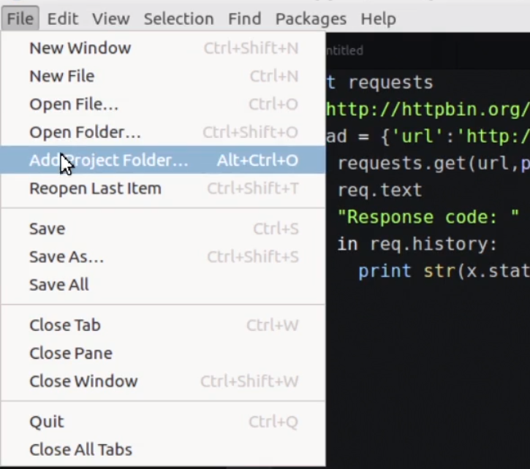
First Scrapy project
The basic structure of a Scrapy project
Open the Atom editor, add this project with ”add a project folder”, and select basic_crawler

Slide 116
Directory structure of the project
basic_crawler/
scrapy.cfg # deploy configuration file
basic_crawler/ # project's Python module, you'll import your code from here
__init__.py
items.py # project items definition file
middlewares.py # project middlewares file
pipelines.py # project pipelines file
settings.py # project settings file
spiders/ # a directory where you'll later put your spiders
# we’ll create a spider in this folder
__init__.py

Slide 117

Create new Python file spiderman.py in ‘basic_crawler/spiders’ directory
BaseSpider: Basic crawling class
Selector: Extracts data using Xpath
Request: Performs the http request to the website
Our class inherits the functionality from BaseSpider
Crawler name
a list of domains, which are allowed to be crawled
Filter the lines containing:
<div class=“book-block-title”
and extract its text

Slide 118
Scraping book titles
We can see div with a class of book-block-title and then the title name.
We need this to define what we want to extract in our crawl process
<div class=“book-block-title” itemprop=“name”>
Practical Machine Learning </div>
Corresponds to the xpath:
//div[@class="book-block-title"]/text()

Slide 119


Create new Python file spiderman.py in ‘basic_crawler/spiders’ directory
name: identifies the Spider. It must be unique within a project, that is, you can’t set the same name for different Spiders.
parse(): a method that will be called to handle the response downloaded for each of the requests made.
The response parameter is an instance of TextResponse that holds the page content and has further helpful methods to handle it.

Slide 120


Executing the code
~/scrapy_projects/basic_crawler$ scrapy crawl basic_crawler
basic_crawler because it is the name of our spider i.e.spiderman.py
And so on

Slide 121


Attention: If you see the following error message:
It is a scrapy bug, either
upgrade to scrapy 1.x or add:
DOWNLOAD_HANDLERS = {'s3': None}
to settings.py

Slide 122
The First Proper Scrapy project
Start a new Scrapy project:
$ scrapy startproject basic_crawler_proper
New Scrapy project 'basic_crawler_proper' created in:
/home/pentester/scrapy_projects/basic_crawler_proper
You can start your first spider with:
cd basic_crawler_proper
scrapy genspider example example.com
Execute in ‘Anaconda prompt’
(for windows 10, in bash for Linux)

Slide 123

The First Proper Scrapy project
We need to specify what are the things we are interested in getting while crawling a website
These things are called items in Scrapy and think about them as our data model
Edit the items.py file and define our first item
We can see the class BasicCrawlerItem was created
Open the Atom editor, add this project with ”add a project folder”, and select basic_crawler_proper

Slide 124

Add this line and delete pass which was already written
Step1: Working on the class BasicCrawlerItem in items.py

Slide 125

Step2: Create new py file spiderman.py in ‘basic_crawler/spiders’ directory as before

Slide 126


Executing the code
~/scrapy_projects/basic_crawler_proper$ scrapy crawl basic_crawler_proper
Writing in a file in json format (must be run from ~/scrapy_projects/basic_crawler_proper$):
$ scrapy crawl basic_crawler_proper -o books.json –t json
Writing in a file in csv format:
$ scrapy crawl basic_crawler_proper -o books.csv –t csv

Slide 127
JSON: JavaScript Object Notation
JSON is a syntax for storing and exchanging data.
JSON is text, written with JavaScript object notation.
When exchanging data between a browser and a server, the data can only be text.
JSON is text, and we can convert any JavaScript object into JSON, and send JSON to the server.
We can also convert any JSON received from the server into JavaScript objects.
This way we can work with the data as JavaScript objects, with no complicated parsing and translations.

Slide 128
JSON examples:
'{"name":"John", "age":31, "city":"New York"}';
[{“Title”:“\n\tLearn Kotlin programming…”},
{{“Title”:“\n\tAngular 6 for Enterprise-Ready Web…”},
…
]

Slide 129
CSV: Comma Separated Values
CSV is a simple file format used to store tabular data, such as a spreadsheet or database.
Files in the CSV format can be imported to and exported from programs that store data in tables, such as Microsoft Excel or OpenOffice Calc.

Slide 130
Name | Class | Dorm | Room | GPA
Sally Whittaker | 2018 | McCarren House | 312 | 3.75
Belinda Jameson | 2017 | Cushing House | 148 | 3.52
Jeff Smith | 2018 | Prescott House | 17-D | 3.20
Sandy Allen | 2019 | Oliver House | 108 | 3.48
Sally Whittaker,2018,McCarren House,312,3.75
Belinda Jameson,2017,Cushing House,148,3.52
Jeff Smith,2018,Prescott House,17-D,3.20
Sandy Allen,2019,Oliver House,108,3.48

Slide 131
Know more about xpaths
http://pythonscraping.com/blog/xpath-and-scrapy
https://blog.michaelyin.info/scrapy-tutorial-7-how-use-xpath-scrapy/

Slide 132
CSF 2113 Programming for Information Security
Penetration Testing (CLO 05)
Muhammad Humayoun, PhD
Assistant Professor
mhumayoun@hct.ac.ae
Abu Dhabi Men’s College

Slide 133
Introduction
Penetration Testing is used to find flaws in the system in order to take appropriate security measures to protect the data and maintain functionality.

Slide 134

Types of Pen Testing
Black Box Penetration Testing
White Box Penetration Testing
Grey Box Penetration Testing

Slide 135
Black Box Penetration Testing
Tester has no idea about the systems that he is going to test.
In other words, the Penn tester is given “ZERO” information about the system inner workings
He is interested to gather information about the target network or system. For example,
in this testing, a tester only knows what should be the expected outcome and he does not know how the outcomes arrives
He does not examine any programming codes

Slide 136
Advantages of Black Box Penetration Testing
Tester need not necessarily be an expert, as it does not demand specific language knowledge
Tester verifies contradictions in the actual system and the specifications
Test is generally conducted with the perspective of a user, not the designer

Slide 137
Disadvantages of Black Box Penetration Testing
Particularly, these kinds of test cases are difficult to design.
Possibly, it is not worth, incase designer has already conducted a test case.
It does not conduct everything.

Slide 138
White Box Penetration Testing
This is a comprehensive testing, as tester has been provided with whole range of information about the systems and/or network such as Schema, Source code, OS details, IP address, etc.
White box penetration testing examines the code coverage and does data flow testing, path testing, loop testing, etc.

Slide 139
Advantages of White Box Penetration Testing
It ensures that all independent paths of a module have been exercised.
It ensures that all logical decisions have been verified along with their true and false value.
It discovers the logical errors
It finds the design errors that may have occurred because of the difference between logical flow of the program and the actual execution

Slide 140
Disadvantages of White Box Penetration Testing
A wide range of expertise is needed to perform such testing
As a consequence, it is expensive

Slide 141
Grey Box Penetration Testing
A tester usually provides partial or limited information about the internal details of the program of a system
Usually access of the source code is not provided to the tester
It can be considered as an attack by an external hacker who had gained illegitimate access to an organization's network infrastructure documents.

Slide 142
Advantages of Grey Box Penetration Testing
As there is clear difference between a developer and a tester, so there is least risk of personal conflict and bias
You don’t need to provide the internal information about the program functions and other operations

Slide 143
Areas of Penetration Testing
Network Penetration Testing
the physical structure of a system needs to be tested to identify the vulnerability and risk which ensures the security in a network.
Application Penetration Testing
the logical structure of the system needs to be tested.
The response or workflow of the system
test the ability of the respective organization to prevent unauthorized access to its information systems.
For instance, using social engineering that gathers information on human interaction

Slide 144
CSF 2113 Programming for Information Security
Resource Discovery (CLO 04)
Muhammad Humayoun, PhD
Assistant Professor
mhumayoun@hct.ac.ae
Abu Dhabi Men’s College
This module is based on the course: Learning Python Web Penetration Testing, www.lynda.com

Slide 145
Table of Contents
Fuzzing
Resource Discovery
Creating the bruteforcer
Improving the result analysis
Automatic screenshots of results

Slide 146
What is Fuzzing?
Fuzz testing (fuzzing) is a Black Box software testing technique used to discover coding errors and security loopholes in software, operating systems or networks.
It involves inputting massive amounts of random data, called fuzz, to the test subject in an attempt to make it crash.
If a vulnerability is found, a software tool called a fuzzer can be used to identify potential causes.
Simple, but offers a high benefit-to-cost ratio and can often reveal serious defects that are overlooked when software is written and debugged.

Slide 147
What makes Fuzzing possible?
User errors
Fuzzing is only useful against a system which:
improperly sanitize input
take more data than it can handle
Sanitizing input: checking user input before storing it in a database or using it for any other purpose to prevent malicious code injection.
Three important Fuzzing tasks that we’ll cover:
Resource Discovery Week 12-13
Password Cracking Week 12-13
SQL Injections Week 14-15

Slide 148
What is Resource Discovery
Discovering what resources are available in the application
A process of building a map or catalog of the application pages and functionalities
How: Dictionary attacks, Brute forcing

Slide 149
Building the first brute forcer for resource discovery using a dictionary of words
Dictionary of words
The most commonly used resources in web applications. These dictionaries are plenty (we’ll use common.txt, commons.txt)
Define the objective of the tool
Make web links using dictionary http://somewebsite/admin (word admin comes from the dictionary)
Find out which pages, files, directories are found using http statuscode 200
Run it against our test web application
The scruffy bank application running at localhost (127.0.0.1)

Slide 150


Slide 151

Step 1: bruteforce-1.0.py – building the basic command line structure
Request library from web request
sys library from getting command line arguments
Defining the main function of our application
If arguments passed on the console are not 3
Print usage function and exit

Slide 152

Get command line arguments
Add /!!!! to the url why?
We’ll replace !!!! with dictionary words later
Printing first ten dictionary words for debugging

Slide 153

Step 1: bruteforce-1.0.py – Output
words is a list of words
Need to remove \n

Slide 154

Step 2: bruteforce-1.1.py – Read words from dictionary one by one, make links and get those pages using Request library
words is a list of words
Need to remove \n
w is a single word
Need to remove \n
w.split(“\n”) returns a list with two elems: [“word”, “”] get val at 0
url contains: http://127.0.0.1/!!!!
Replace !!!! With word
e.g. http://127.0.0.1/wfuzz
2nd time: http://127.0.0.1/test
And so on …
Get the page
r.status_code contains its status code

Slide 155

Step 2: bruteforce-1.1.py – Output
Try commons.txt instead of common.txt
commons.txt is a very large file. There will be a lot more results with status code 404 (Page not found)
We are only interested in those links for which a page is found
So it seems better not to print those links with 404 status code for readability

Slide 156

Step 3: bruteforce-1.2.py – Do not print those results that have status code 404

Slide 157


Step 3: bruteforce-1.2.py – Output
Redirection page. Lets us visit it in browser

Slide 158
URL redirection
URL redirection (also called URL forwarding), is a technique for making a web page available under more than one URL address.
When a web browser attempts to open a URL that has been redirected, a page with a different URL is opened.
URL redirection may be needed for various reasons:
for URL shortening
to prevent broken links when web pages are moved
to allow multiple domain names belonging to the same company (or organization) to refer to a single web site.
Ex. wikipedia.com and wikipedia.net are automatically redirected to wikipedia.org
for hostile purposes such as phishing attacks or malware distribution

Slide 159
URL redirection and resource discovery
For discovering resources, detecting URL redirection is important
Instead of saving redirect links, we want to save those urls where the redirects were taking us.

Slide 160
Redirect status codes and characteristics
HTTP Status Code | HTTP Version | Temporary / Permanent
301 | HTTP/1.0 | Permanent: The page has moved permanently
302 | HTTP/1.0 | Temporary: The page has moved temporarily
303 | HTTP/1.1 | Temporary: The page has moved temporarily
307 | HTTP/1.1 | Temporary: The page has moved temporarily
308 | HTTP/1.1 | Permanent: The page has moved permanently

Slide 161

Step 4: bruteforce-1.3.py – Detecting Redirections

Slide 162

Step 4: bruteforce-1.3.py – output

Slide 163

Step 5: bruteforce-1.4.py – Taking snapshots
First a simple example:

Slide 164


Step 5: bruteforce-1.4.py – Taking snapshots
Taking snapshot of every resource returning 200 status code
A way to speed up the analysis of big apps or when testing multiple apps in a short period of time
Needed libraries are:
Selenium web driver for Python and Phantom JS
Selenium web driver is a tool used to automate web browsers programmatically
PhantomJS is a headless browser
http://phantomjs.org/
https://www.seleniumhq.org/

Slide 165

Step 5: bruteforce-1.4.py – Taking snapshots
A test example
Try this instead: driver = webdriver.Firefox()

Slide 166


Step 5: bruteforce-1.4.py – Taking snapshots
A test example
$ python test-selenium.py

Slide 167


Step 5: bruteforce-1.4.py – Taking snapshots

Slide 168

Step 5: bruteforce-1.4.py – Taking snapshots

Slide 169


Step 5: bruteforce-1.4.py – Output

